Slide 1

Department of Information Technology
NBA Accredited A.P. Shah Institute of Technology G.B.Road,Kasarvadavli, Thane(W), Mumbai-400615 UNIVERSITY OF MUMBAI Academic Year 2021-2022

Slide 2
A Project Presentation on Chess AI Submitted in partial fulfillment of the degree of Bachelor of Engineering(Sem-6) in INFORMATION TECHNOLOGY By Ayush Jain (18104005) Anand Morye (19104018) Neel Dudheliya (19104049) Under the Guidance of Prof. Jayshree Jha

Slide 3
1.Project Conception and Initiation

Slide 4
1.1 Objectives
To build an AI program that can play chess with a rating of at least 1500.
To build a user-friendly drag and drop UI for easy game interactions.
To use piece evaluation functions for better position prediction.
To use and optimize search algorithms like Min-Max & Alpha-Beta Pruning.
To build an AI program that can follow basic chess rules & regulation including piece movement, legal and illegal moves, castling,etc.
To build an AI program that can predict move upto the depth of 5.

Slide 5
1.2 Literature Review
In a 1999 paper, Ulrich Schawlbe and Paul Walker discuss Zermelo’s work and contribution to the research area of chess solvability. The main questions he tried to answer were :
When is a player in a “winning” position and can this be defined in a mathematical sense?
If a player is in a winning position, can we determine the number of moves needed to force a win?

Slide 6
1.3 Problem Definition
Chess is a complex game with abundant amount of possibilities. A computer program must follow the rules of chess while also develop a winning strategy.
Since the state of the game varies with each move, Keeping a track of states becomes harder.
Chess is a game with some special moves/rules that a player must follow including :-
Castling (A King and a Rook manuever).
En Passant (a special Pawn capture).
Threefold repitition (for draw).
Pawn Promotion.

Slide 7
1.4 Scope
User can train himself in single-player offline mode and test its skill against the AI
User can make new strategies and test his pre-game strategies against the AI
User can increase their problem solving skills
User can improve their concentration by playing chess
User can increase their cognitive skills
User can develop ability to think rationally as well as logically

Slide 8
1.5 Technology stack
Front-end :- HTML, CSS, Javascript
Back-end :- Flask
Libraries used :- Python ( python-chess )
Javascript ( chessboard.js & chess.js )

Slide 9
2. Project Design

Slide 10
2.1 Proposed System
In chess we are using a game tree which is a directed graph whose nodes are positions in the game and edges are moves the player make.
Game tree will have all required states of a particular chess game.
For finding the best possible move from the Game tree, Searching algorithms like Min-Max will be used with iterative deepening. To increase the computation speed we will use Alpha-Beta prunning.
For special rules in chess such as Castling, Pawn promotion, en passant special boolean functions will be use to determine if such rules are applicable or not.

Slide 11
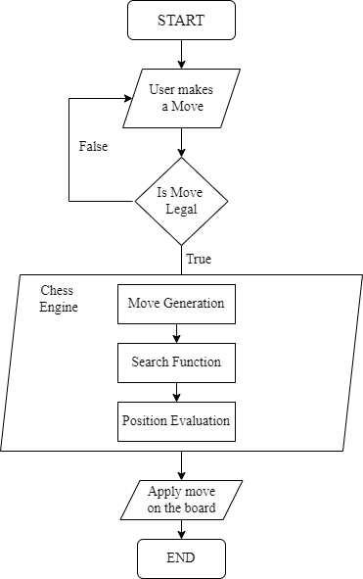
2.2 Design(Flow Of Modules)
Chess Engine Flow chart:-
Notes:
This is a flow diagram of our chess engine. After registering move from the user we need to validate the move whether it is legal or not. explain stuff...... In move generation game tree of possible board positions is created. Search function will search that game tree and find the optimal move with position evaluation.

Slide 12
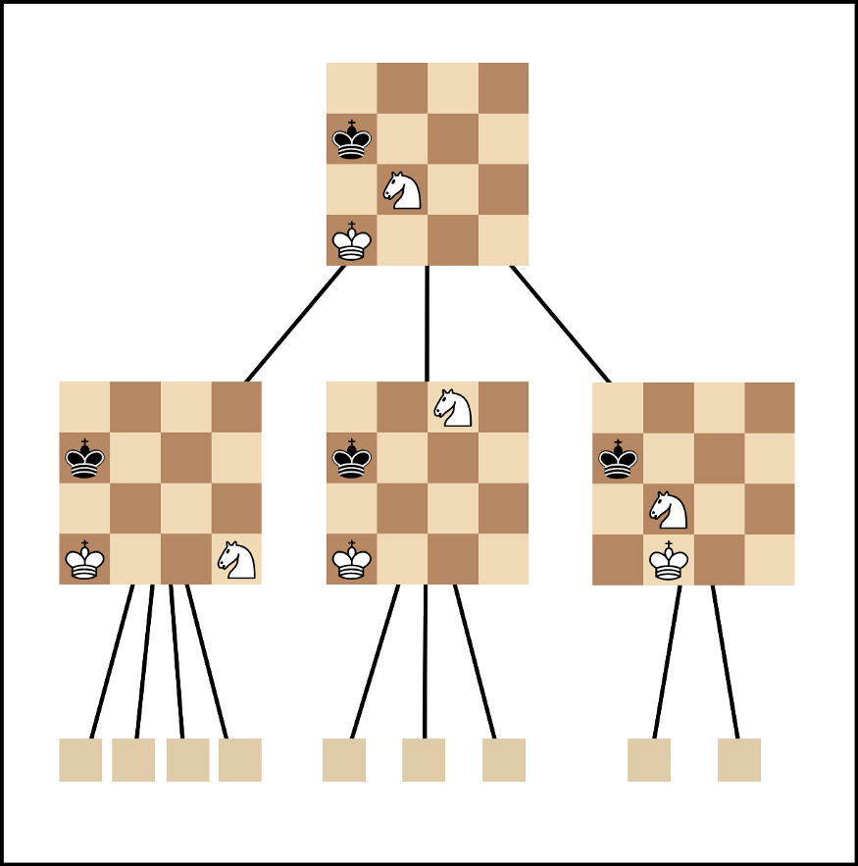
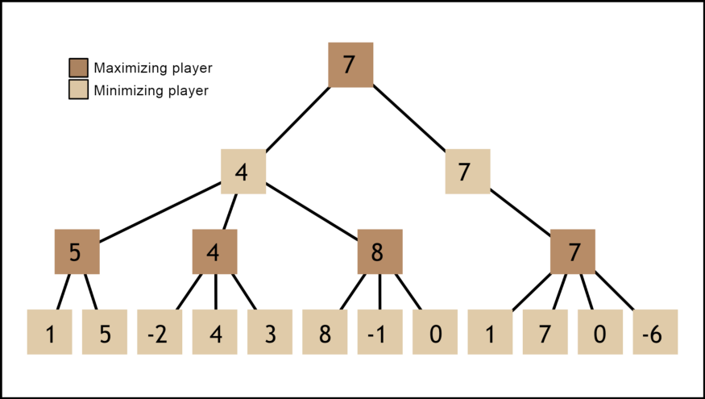
2.2 Design(Flow Of Modules)
Search function :- Min-Max Algorithms

Slide 13
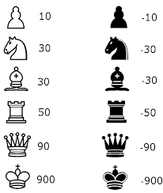
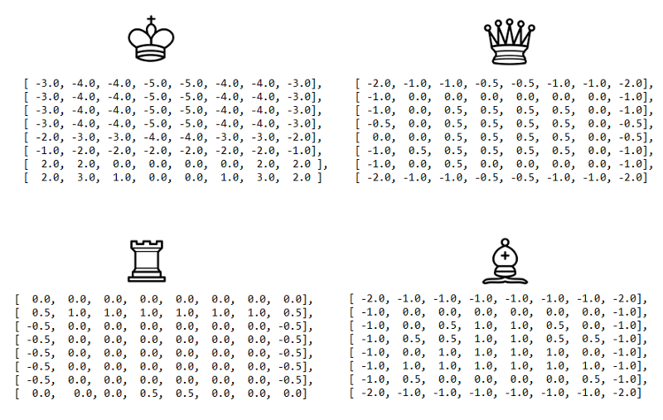
2.2 Design(Flow Of Modules)
Evaluation function :-

Slide 14
3. Implementation

Slide 15
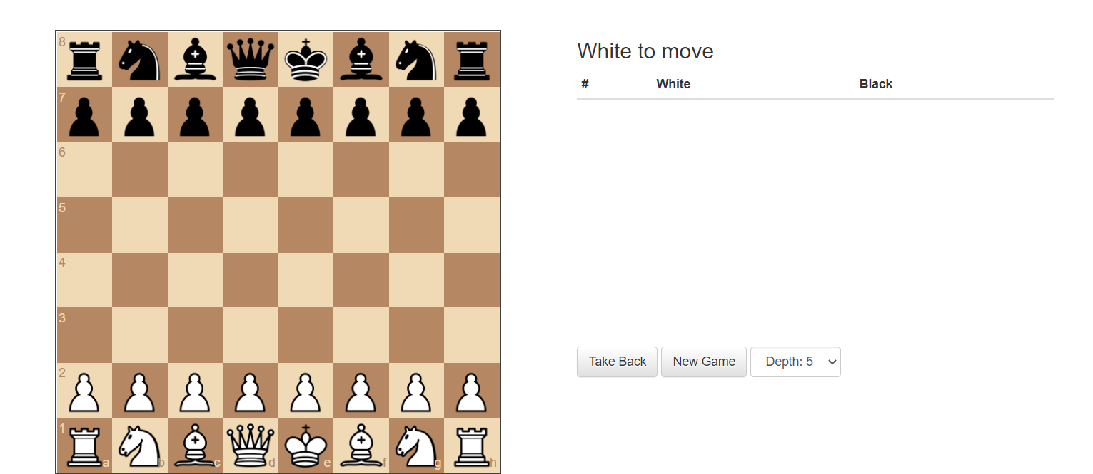
3.1 GUI ( Web App )

Slide 16
4. Result

Slide 17
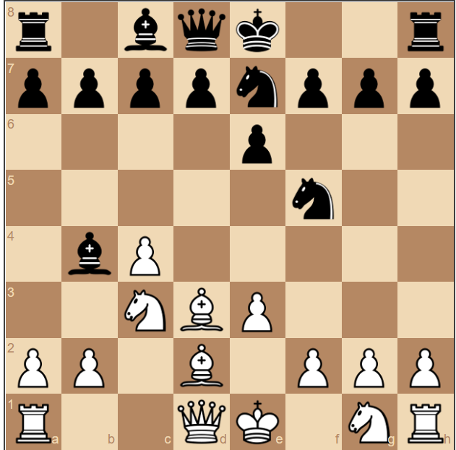
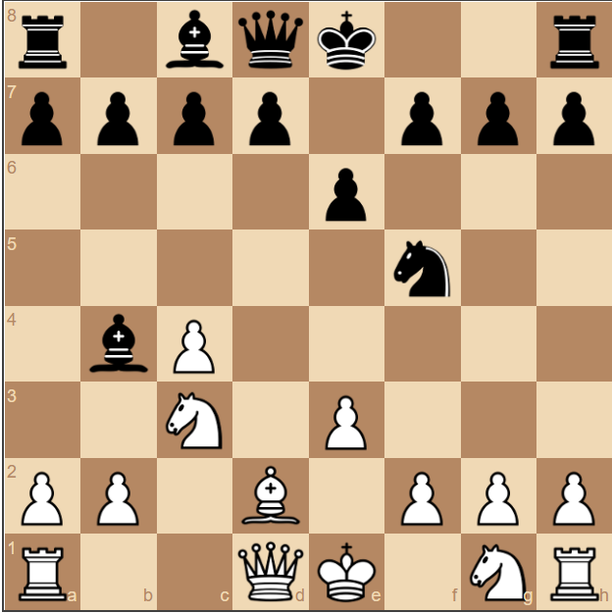
4.1 Chess Engine ( Gameplay )

Slide 18
5. Conclusion and Future Scope

Slide 19
Conclusion & Future Scope
In this project “ Chess AI ” we presented the classic and standard version of chess AI implemented as a GUI. The strength of even a simple chess-playing algorithm is that it doesn’t make stupid mistakes. We've been able to program a chess-playing algorithm that can play chess.
Eventhough we can play chess our algorithm lacks strategic understanding like sacrificing a piece for a future better position. Also restricting the depth of the algorithm would result in “horizon effect”. To overcome this problem we could use Quiescence Searching algorithm to increase the depth we can search for good moves.

Slide 20
References
Zermelo's Work - https://people.math.harvard.edu/~elkies/FS23j.03/zermelo.pdf
FreeCodeCamp guide for understanding the workflow of chess engine - https://www.freecodecamp.org/news/simple-chess-ai-step-by-step-1d55a9266977/
https://thesmartcoder.dev/build-a-simple-chess-ai-in-javascript/

Slide 21
Thank You

